Slide 1
Introduction to Analytics
Lecture I

Slide 2
Agenda
Background of Analytics
Business Analysis vs Business Analytics
Introduction to Data Analytics
Operational vs Analytical Approach

Slide 3
Business Analysis vs Business Analytics

Slide 4
Comparing Business Analysis and Business Analytics
Business Analysis is defined as the discipline of recognizing business needs and determining solutions to certain business problems.
It can also comprise of organizational change, process improvement or strategic planning and policy development.
Business Analytics refers to the collection of tools, techniques and skills which aid the investigation of past business performance.
It includes statistical or quantitative analysis, data mining, predictive modeling and multivariate testing.
The main difference between the two is that Business Analysis is more related to functions and processes while Business Analytics is usually related with data and reporting.

Slide 5
Introduction to Data Analytics

Slide 6
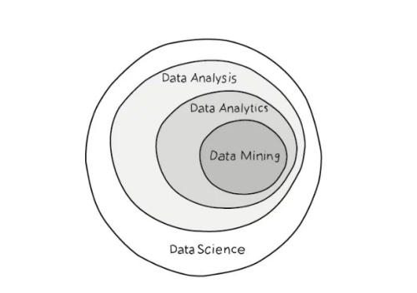
Layers of Data Processing

Slide 7
Data Analysis
Data analysis is the process of examining, transforming, and arranging raw data in a specific way to generate useful information from it.
It allows for the evaluation of data through analytical and logical reasoning to lead to some sort of outcome or conclusion in some context.
The approach to data analysis depends largely on the type of data available for analysis and the purpose of the analysis.
It can be also be defined as a way to interpret the data and derive meaningful insights from the data.
Let’s say, an executive wants to know, “Who are the top 10 sales folks who exceeded their allotted targets this year in U.S. region?”. Well, one can extract the U.S. sales data from the tool and sort it by descending order to arrive at the top 10.

Slide 8
Data Analytics
Data Analytics also holds true in deriving meaningful insights from the data. It is processing recorded data by means of mathematics, statistics and predictive modeling.
Major difference between Analysis and Analytics is that analytics involves statistical tools & techniques with business acumen to bring out the hidden patterns, stories and meaningful correlations from the data.
For example, customer retention can be improved by then using analytics to predict which customers are in danger of defecting.
In short, Data Analytics = Business + Statistics (Applied Maths) + Computer Programming

Slide 9
Why Analytics?
It can uncover correlations and patterns to help answer the following types of questions:
What happened?
How or why did it happen?
What’s happening now?
What is likely to happen next?

Slide 10
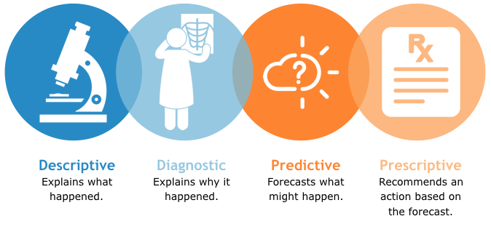
Types of Analytics

Slide 11
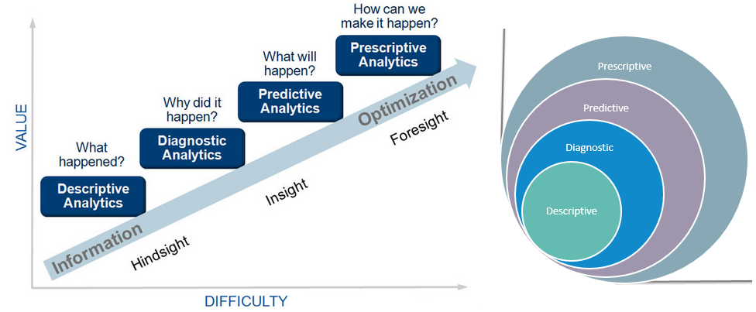
Layers of Analytics

Slide 12
Descriptive Analytics
Descriptive statistics have been around the longest. These models help executives in finding answers for the question - “What has happened?”
It is carried out on a daily basis, to answer questions like - how we are doing, what is happening in the business and how that is affecting overall performance.
Descriptive analytics are useful because they allow us to learn from past behaviors, and understand how they might influence future outcomes.
Common examples of descriptive analytics are reports that provide historical insights regarding the company’s production, financials, operations, sales, finance, inventory and customers

Slide 13
Predictive Analytics
Predictive analytics has become more dominant recently due to the desire to predict customer behavior. These models help executives in finding answers for the question - “What might happen?”
Predictive analytics has its roots in the ability to “Predict” what might happen. It provides companies with actionable insights based on data.
It provide estimates about the likelihood of a future outcome. It is important to remember that no statistical algorithm can “predict” the future with 100% certainty.
Typical business uses include, understanding how sales might close at the end of the year, predicting what items customers will purchase together, or forecasting inventory levels

Slide 14
Prescriptive Analytics
The relatively new field of prescriptive analytics allows users to “prescribe” a number of different possible actions to and guide them towards a solution. In a nut-shell, these analytics are all about providing advice. These models help executives in finding answers for the question - “What should we do?”
These analytics go beyond descriptive and predictive analytics by recommending one or more possible courses of action. Essentially they predict multiple futures and allow companies to assess a number of possible outcomes based upon their actions.
Even though prescriptive analytics is as valuable as predictive, it is not used commonly. According to Gartner report, around 13 percent of organizations are using predictive but only 3 percent are using prescriptive analytics.
Larger companies are successfully using prescriptive analytics to optimize production, scheduling and inventory in the supply chain to make sure that are delivering the right products at the right time and optimizing the customer experience.

Slide 15
Operational vs Analytical Approach

Slide 16
Operational vs Analytical reports
Operational reporting is collecting & reporting of organizational information on an hourly, daily, weekly. It is oriented towards supporting the day-to-day organizational functions.
Even though, it provides a snapshot of business performance in a given time period, it relies on the receiver to analyze and contextualize the reported data. So it doesn’t reflect the actual inefficiencies within the organization.

Slide 17
Operational vs Analytical reports…
On contrary, Analytical reporting focuses on supporting the strategic and planning functions of senior management and it is dynamic unlike operational which is static in nature.
Businesses have a lot of data available than before so they can utilize it to streamline existing processes. Analytical reports help them to understand customer behavior better, monitor current trends and make strategic decisions more efficiently.

Slide 18
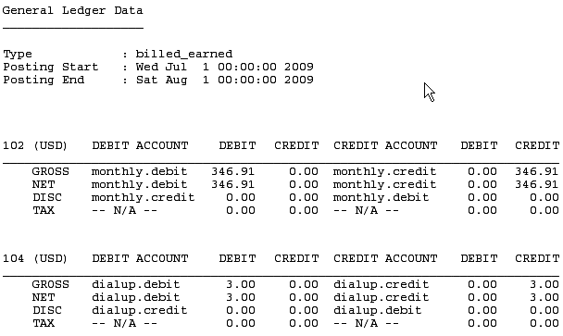
Operational Report I

Slide 19
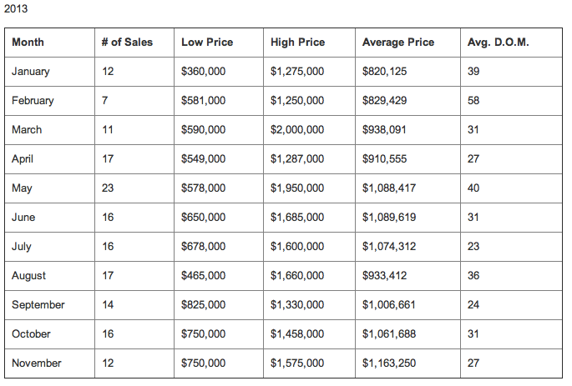
Operational Report II

Slide 20
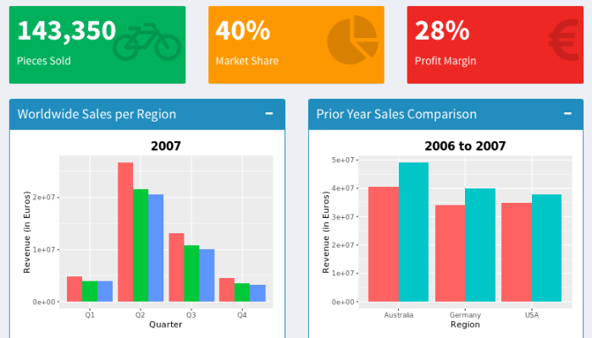
Simple Analytical Report

Slide 21
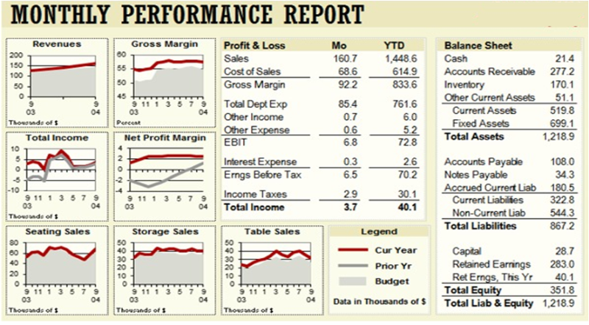
Complex Analytical Report

Slide 22
Analytics Lifecycle
Define a question
Data Understanding
Define Ideal Dataset
Determine what data you can access
Business Understanding
Data Preparation
Obtain the data
Clean the data
Deployment
Data Exploration
Predictive Modelling
Interpretation of results
Create reproducible code
Distribute results to all the types of users
Modelling
Evaluation
Evaluate / Challenge the results
Synthesize / write-up results
Notes:
Cross Industry Standard Process for Data Mining

Slide 23


